Slide 1
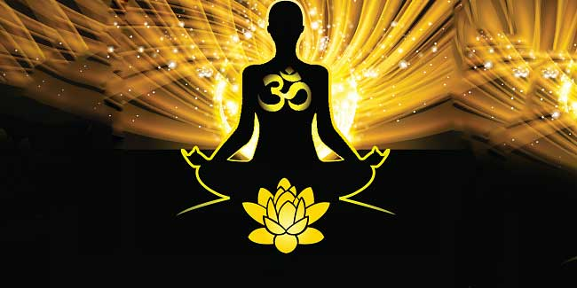
Subject name: YOGA AND HUMAN CONSCIOUSNESS Subject Code: YG-1081

Slide 2
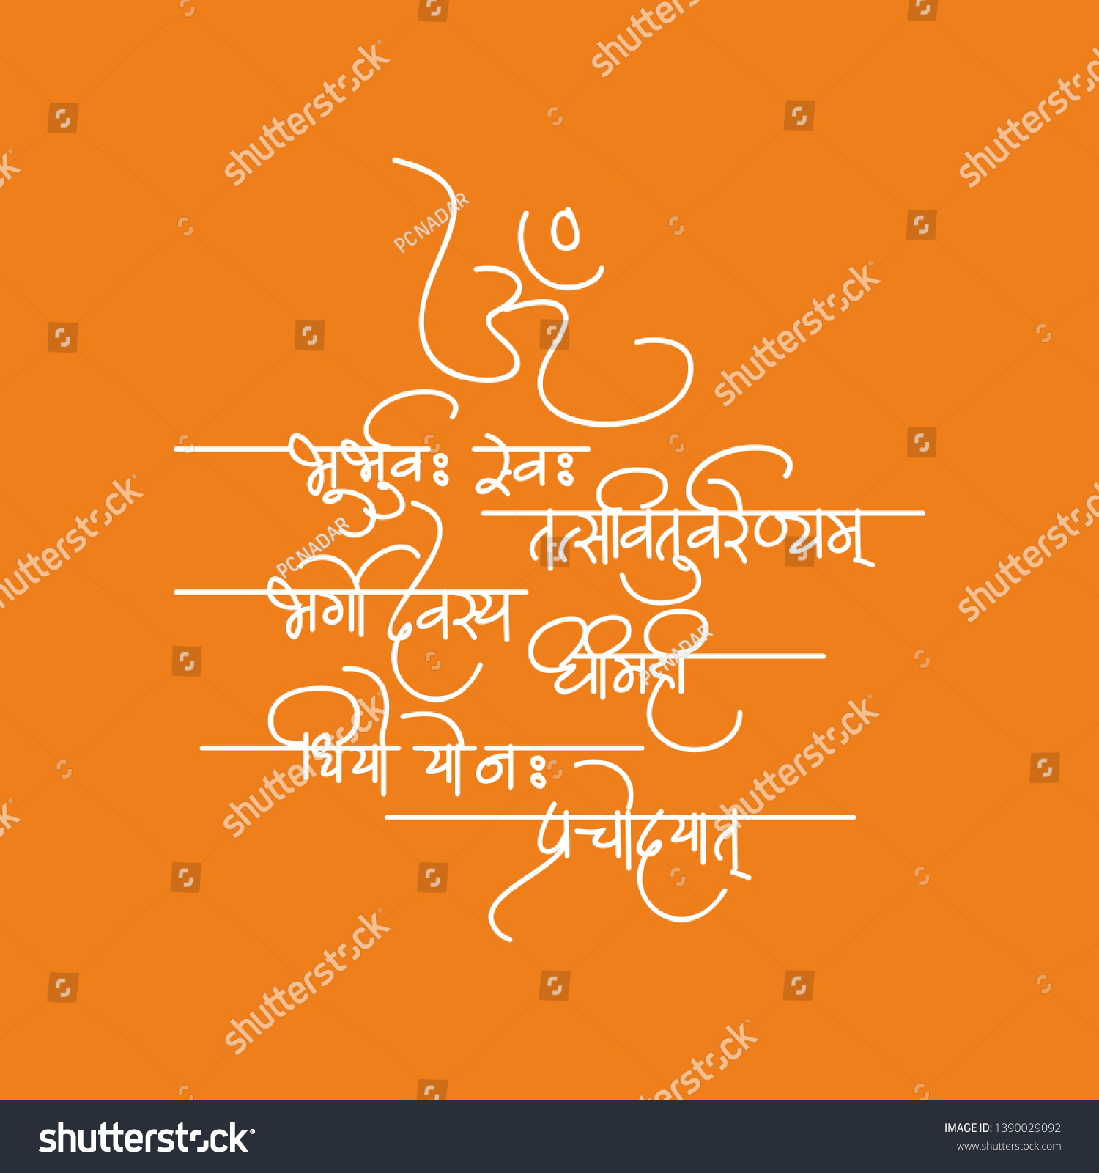
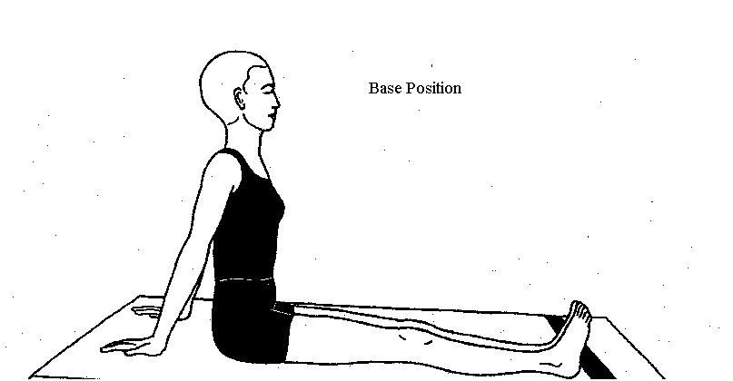

Slide 3
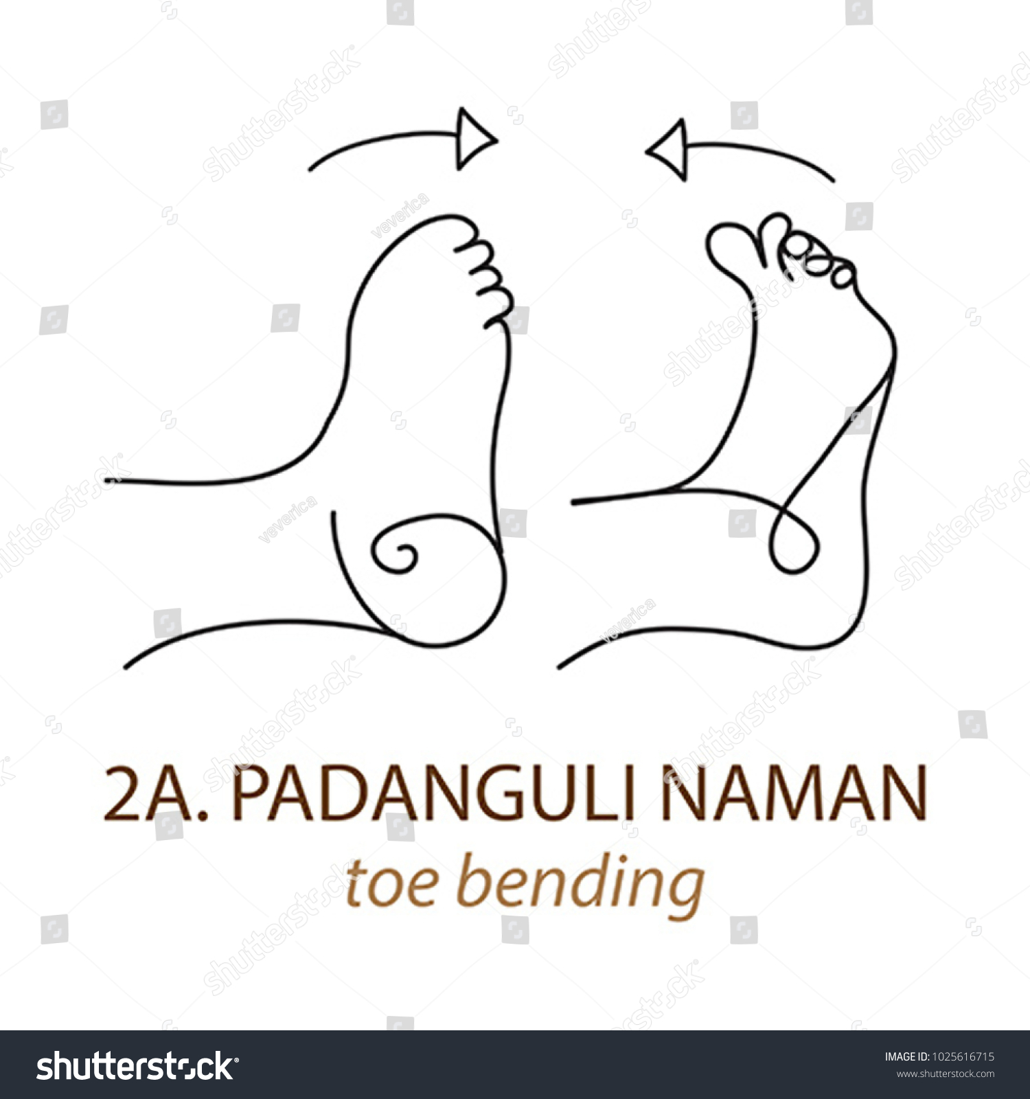
Breathing :- Inhale as the toes move backward.
Exhale as the toes move forward.
● Benefits :- Toes bending into the earth is fantastic for posture. Our feet are our foundations for walking, running, yoga, etc. If our foundation is tight and good condition, our posture will be as well.

Slide 4
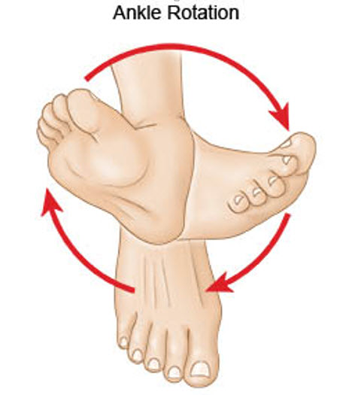
Breathing :- Inhale on the upward movement.
Exhale on the downward movement.
● Awareness :- On the rotation of the ankle and the breath.
● Benefits :- Ankle rotation are a dynamic stretching exercise that opens up your ankle joints and helps release stress and tension. This exercise also improves your flexibility and warms up your feet, and ankles, exercise-related injuries.

Slide 5
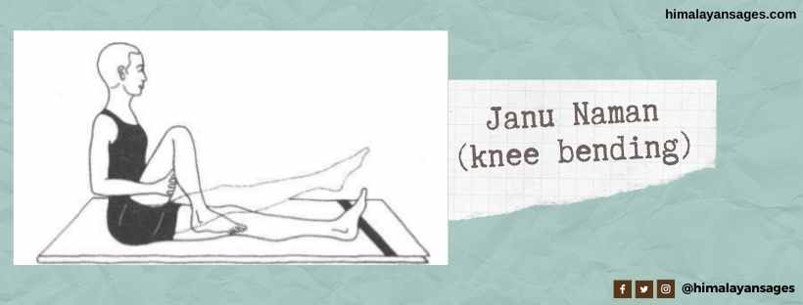
● Breathing :- Inhale on the upward movement.
Exhale on the downward movement.
● Awareness :- On the movement of rotation and the breath.
● Benefits :- If you struggle with knee pain, knee bending may offer relief. A regular knee bending asana routine can help maintain good strength in the knees.
Knee bending from a functional standpoint, the deep knee bend is excellent especially at improving or maintaining feet and ankle stability.
● Contra-indications :- Knee bending practice should not be attempted by people with week back conditions, high blood pressure or heart conditions.

Slide 6
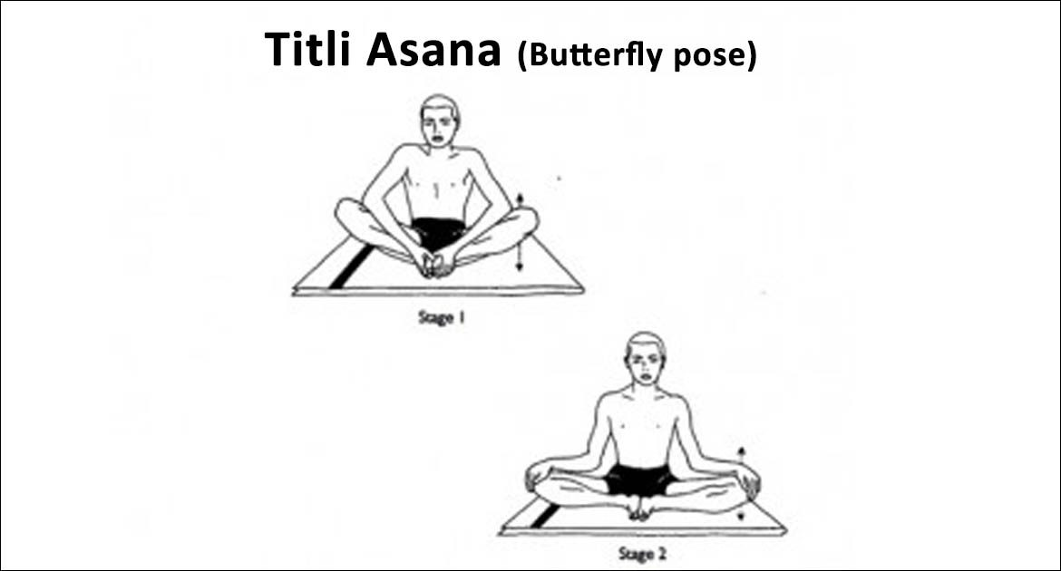
Breathing :- During butterfly breathing should be normal.
Awareness :- On the movements of the knee , ankle and hip joints.
Benefits :- Those people who not sit in cross-legged positions should practice butterfly asana daily, both morning and evening. People who stand or walk for long hours will especially benefit from this pose as it will enhance their energy levels.
Contra-indications :- In case of any type of an injury in the knee, ankles, hip surgery should avoid this pose.

Slide 7
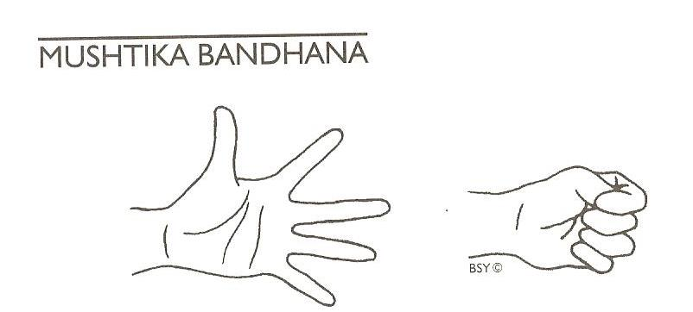
Breathing :- Inhale on opening the hands.
Exhale on closing the hands.
● Benefits :- Stretching improves the flow of blood to your hands.

Slide 8
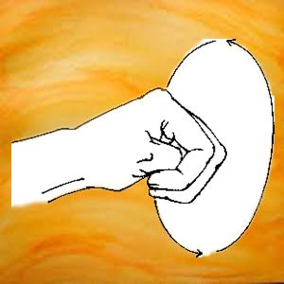
Manibhanda Chakra (wrist joint rotation)
Right arm forward at shoulder level, fist with thumb inside. Rotate fist about the wrist, palm facing downward throughout, arms and elbows remain straight. 10 times Both arms. 10 times in each direction. Rotate fists together in the opposite direction: 10 in each direction.
● Benefits :- This movement actively strengthens the wrists, and its passive effect is the strengthening of the fingers bones too.

Slide 9
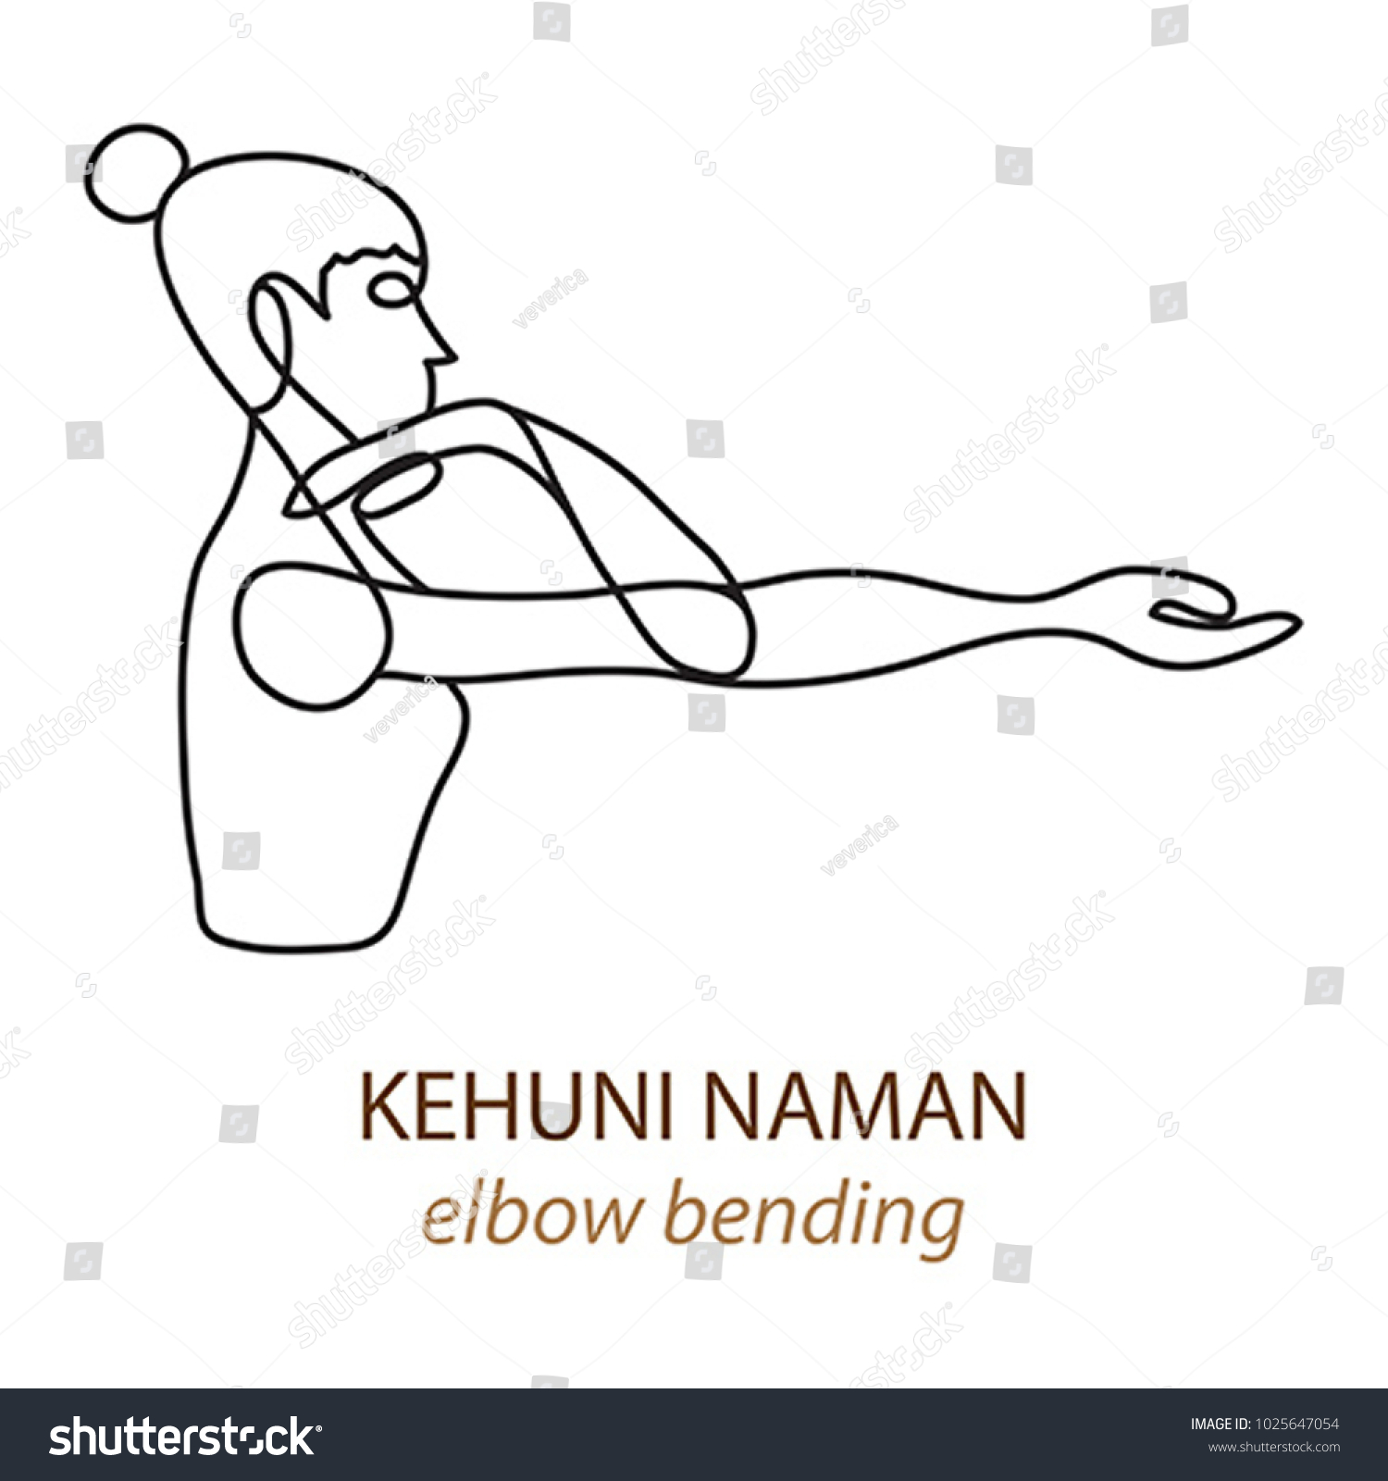
Kehuni Naman (elbow bending) :- Arms in front, shoulder level. Hands open palms up. Bend arms at elbows, touch fingers to shoulders, straighten again. Do 10 times.
Arms sideways at shoulder level, hands open, palms up. Fingers to shoulders. Again straighten. 10 times. Inhale while Straight, exhale while bending.
Benefits :- This dynamic movement will help in building flexibility with your elbows keeping the movement of the fingers and wrist active and also help in releasing the heaviness or pain at the elbows.

Slide 10
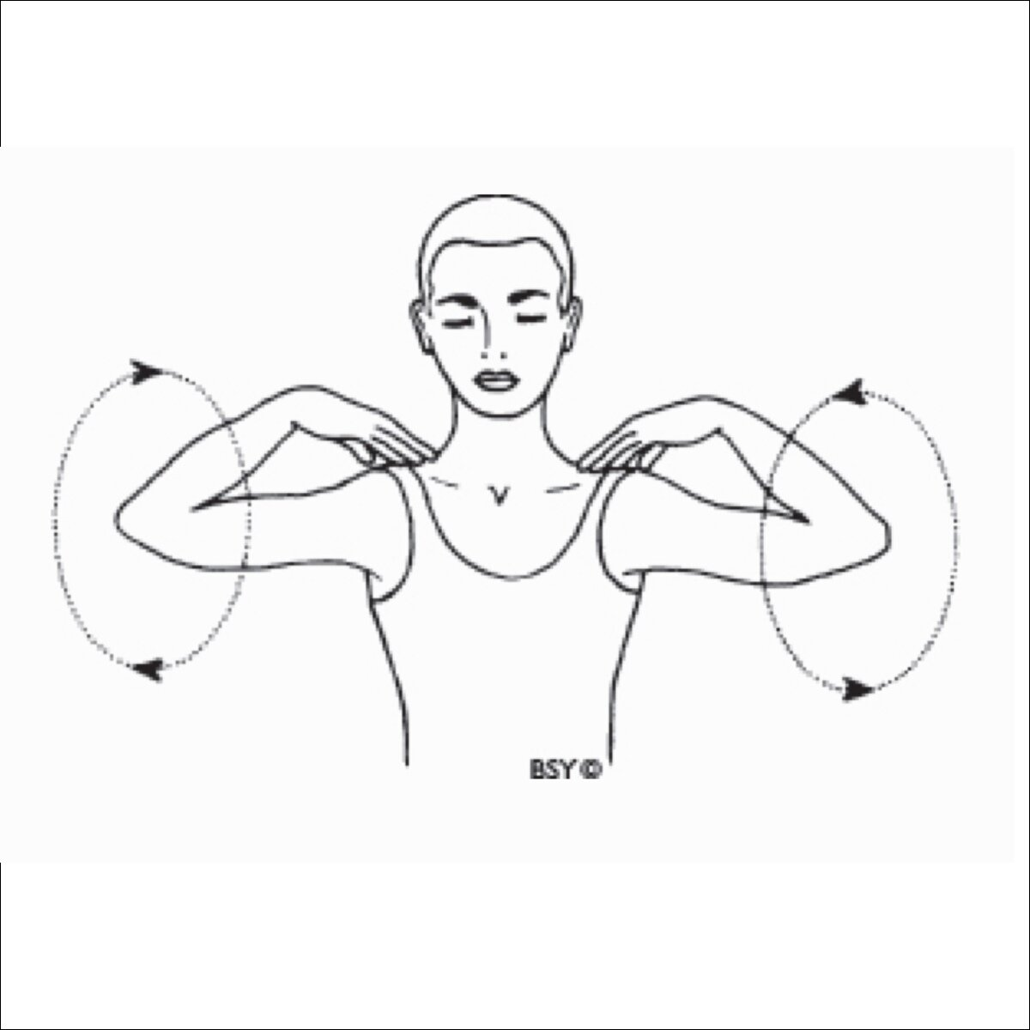
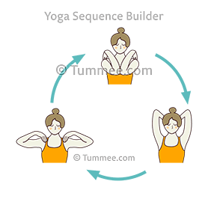
Skandha Chakra (shoulder rotation) :- Fingers of right hand to right shoulder, left hand on left knee. Rotate elbow in large circle 10 times each way.
Left hand left shoulder, right hand right shoulder. Rotate both elbows. Try to touch elbows in front of chest, the ears while movement up. Sides of trunk while coming down. 10 times each way. Inhale on upward stroke, exhale on downward
Benefits :- Reduce neck pain, Effects on chest muscles:- By doing Skanda Chakrasana, a person can make the muscles around his chest strong and flexible.
Increase blood circulation:- By doing the skandha chakra, there is a stretch on our chest, due to which the circulation of blood around our heart is done properly.

Slide 11
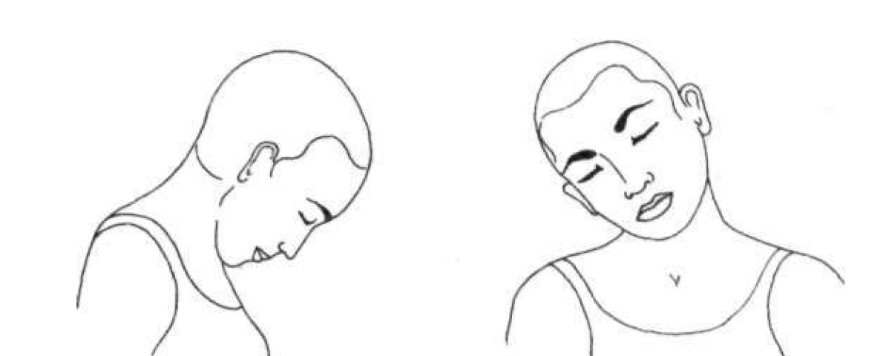
Neck Movements
Cervical flexion: bending the head forward towards the chest. Cervical extension: bending the head backward with the face towards the sky. Cervical rotation: turning the head to the left or the right. Cervical side-bending: tipping the head to the side or touching an ear to the shoulder of the same side.
Other neck movements include:
rotating the neck from side to side
bending the neck laterally to bring the ear to the shoulder
extending the neck to lift the chin upward
In neck flexion, a normal range of motion is 40 to 80 degrees, which is measured by a device called a goniometry. This shows how far you can move your neck without experiencing pain, discomfort, or resistance.
Healthy joints, muscles, and bones help to maintain a normal range of motion.

Slide 12
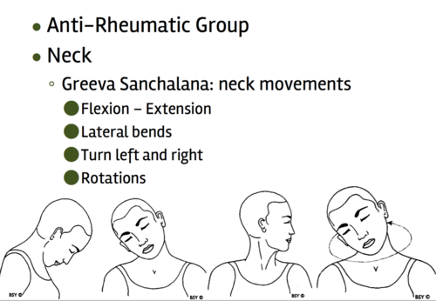

Slide 13
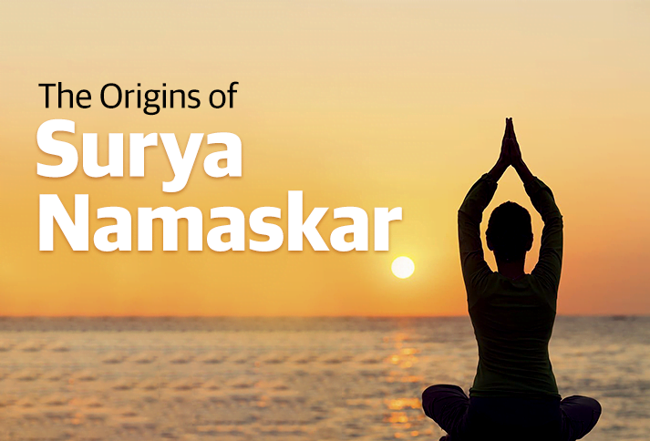

Slide 14
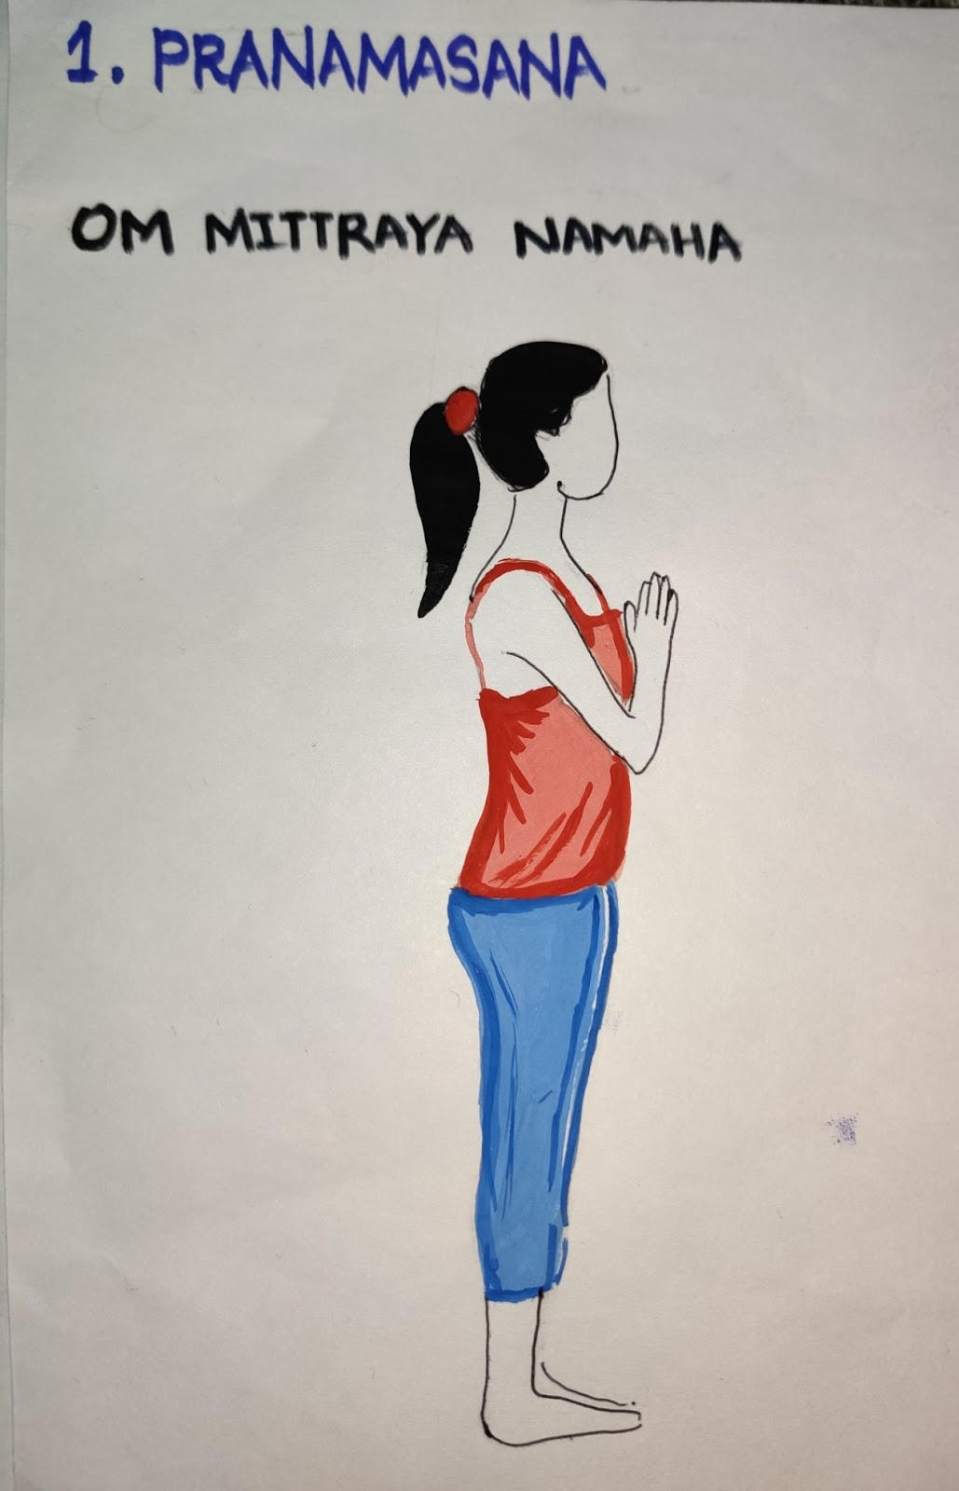
Start by standing straight at the front of your mat, bringing your feet together, and keeping arms loose alongside.
Now, close your eyes and bring your palms to meet in the center of your chest. Relax the whole body.
Benefits:
This pose relaxes the nervous system and helps in gaining the balance of the body.
It also helps relieve stress and anxiety.

Slide 15
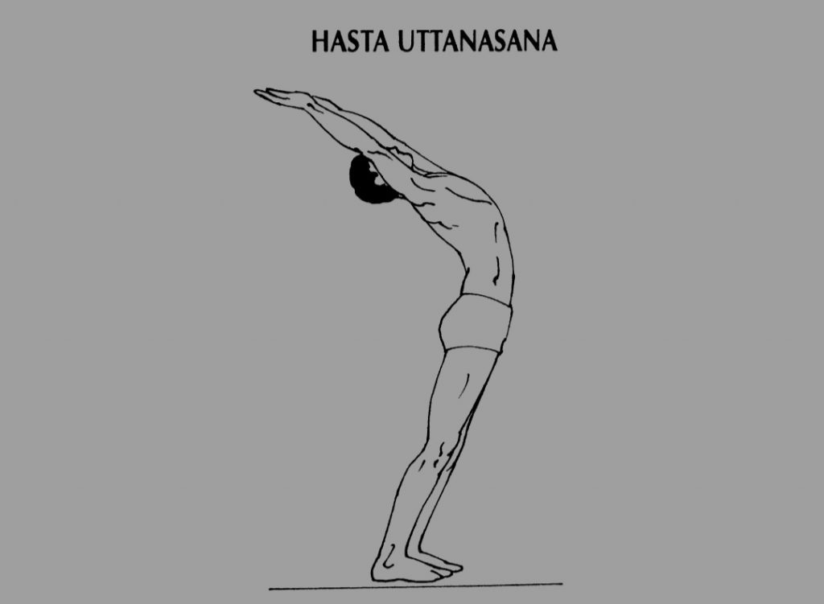
Aum Ravayre Namah
Hasta Uttanasana is started by exhaling deeply
Inhale deeply thereafter stretching your arms forward and bringing them up over your head.
Look up and stretch the body slightly backward by pushing your pelvis forward.
Breathe out. (Focus on breathing-in when you arch backward, and as you bend forward breathe-out.)
Benefits:
Stretches and tones the muscles of the abdomen.
Expands the whole body from heel to the tip of the fingers.

Slide 16
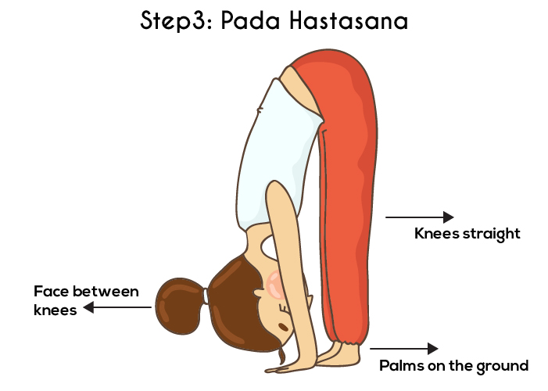
Aum Suryaya Namah
Exhale and start to fold forward and down to the knees; as you come forward, keep the spine long.
Hands down on the floor, have just your fingertips touching the floor.
Bend the knees just enough so your chest can rest against the thighs, and your head touching your knee. Hold this position for a few seconds.
Benefits:
It stretches the spine and makes it flexible.
It also stretches the hamstrings and opens the legs, shoulders, and arms muscles

Slide 17
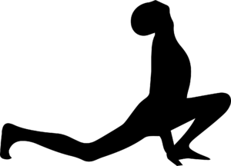
OM Bhanave Namah - I bow to the brilliant one
Ashwa Sanchalanasana
Next, step your right leg back, putting just the knee down and comfortably tucking the toes under.
At the same time bend the left knee leaving the foot flat on the floor.
Press the fingertips or palms down to the floor, roll the shoulders back, and slowly lookup.
Benefits:
Strengthens the leg muscles and spine.
Relieves in indigestion and constipation.

Slide 18
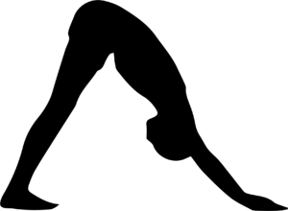
OM Khagaya Namah - I bow to the moving one in the sky
Pose 5: Mountain pose – Parvatasana
Slowly exhale, having control bring your palms onto the floor and stepping the left foot back beside the right, lift your hips up into the air.
Lengthening through your spine, bring the shoulders towards the ankles. Take a few breaths.
Benefits:
It improves posture and calms the mind.

Slide 19
Parvatasana contraindications ● Spinal injury. ● Frozen shoulder. ● Backache. ● Arthritis. ● Hypertension. ● Cardiac problems. ● Carpal tunnel syndrome. ● It should avoid in case of injury in wrist, elbows, hips, neck and shoulder.

Slide 20

OM Hruh Pooshne Namah - I bow to the giver of nutrition
Pose 6: Ashtanga Namaskara
As you exhale, lower your knees down and slowly, with a controlled chest, come down while pushing your head forward on the floor.
Keep your elbows right in against your sides; giving you more strength.
Now, as you build more strength in this transition, you can lower the chest down and still keep your hip up in the air.
Benefits:
It improves the flexibility of the back and spine.
Strengthens the back muscle and relieves build up tension.
Your eight body parts are worked in a single pose.

Slide 21
Contraindications, Precautions for doing Ashtanga Namaskara ● Carpal tunnel syndrome. ●Wrist pain and injury. ● Recent injuries to your neck, shoulder or elbow. ● Injury to any part of the body. ● Those recovering from surgery. ● High blood pressure. ● Migraine.

Slide 22
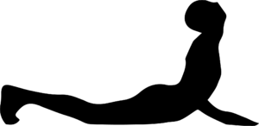
Hiranyagarbhaya Namah - I bow to the golden centred one
Pose 7: Cobra pose – Bhujangasana
Keep hands and feet right where they are. And inhale.
Slide forward and raise your chest like a cobra.
Roll the shoulders back, Keep your elbows bent, and squeeze them back towards each other.
Slowly lookup.
Benefits:
It improves flexibility and mood.
It stretches the shoulders, chest, back, legs muscle, all at once.
Contraindications of Bhujangasana:
People suffering from a hernia, back injuries, headaches, and recent abdominal surgeries should not perform this asana.
Pregnant women should not perform this asana.

Slide 23
